Slide 1
Driver:
A driver is a software component that provides the facility to a computer to communicate with hardware.
JDBC driver:
A driver is a software component that provides the facility to interact java application with the database.
Types of JDBC drivers:
JDBC-ODBC bridge driver.
Native-API driver.
Network-Protocol driver.
Thin driver.

Slide 2
1. JDBC-ODBC bridge driver
JDBC-ODBC bridge driver is a native code driver which uses ODBC driver to connect with the database. It converts JDBC method calls into ODBC function calls. It is also known as Type 1 driver.
The JDBC-ODBC Bridge that comes with JDK 1.2 is a good example of this kind of driver.

Slide 3
Advantages:
It can be used with any database for which an ODBC driver is installed.
Disadvantages:
Performance is not good as it converts JDBC method calls into ODBC function calls.
ODBC driver needs to be installed on the client machine.
Platform dependent.

Slide 4
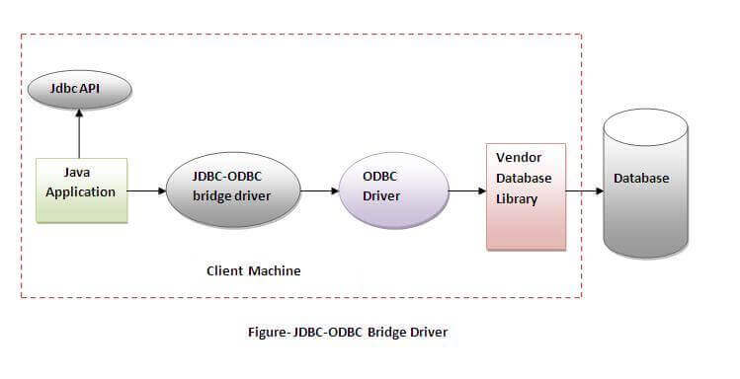

Slide 5
2. Native-API driver
Native-API driver uses the client-side libraries of the database. It converts JDBC method calls into native calls of the database API. It is partially written in java. It is also known as Type 2 driver.
The Oracle Call Interface (OCI) driver is an example of a Type 2 driver.

Slide 6
Advantages:
It is faster than a JDBC-ODBC bridge driver.
Disadvantages:
Platform dependent.
The vendor client library needs to be installed on the client machine.

Slide 7
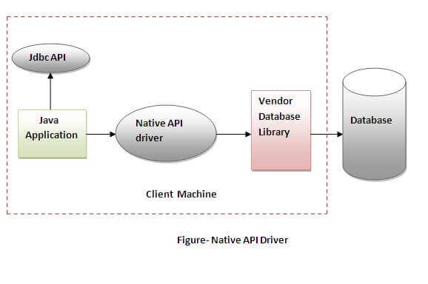

Slide 8
3. Network-Protocol driver
Network-Protocol driver is a pure java driver which uses a middle-tier to converts JDBC calls directly or indirectly into database specific calls. Multiple types of databases can be accessed at the same time. It is a platform independent driver.
It is also known as Type 3 or MiddleWare driver.

Slide 9
Advantages:
Platform independent.
Faster from Type1 and Type2 drivers.
It follows a three tier communication approach.
Multiple types of databases can be accessed at the same time.
Disadvantages:
It requires database-specific coding to be done in the middle tier.

Slide 10
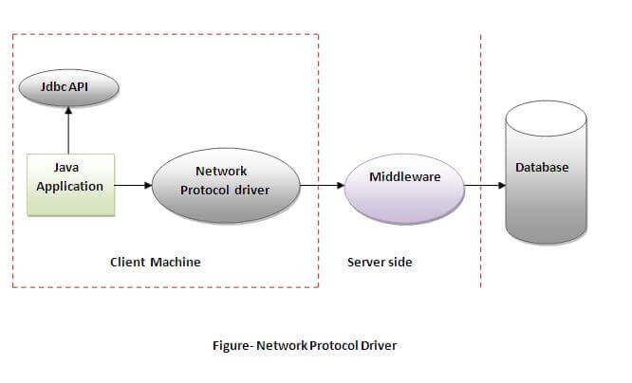

Slide 11
4. Thin driver
Thin driver is a pure java driver which converts JDBC calls directly into the database specific calls. It is a platform independent driver. It is also known as Type 4 or Database-Protocol driver.
MySQL's Connector/J driver is a Type 4 driver.

Slide 12
Advantages:
Platform independent.
Faster than all other drivers.
Disadvantages:
Multiple types of databases can’t be accessed at the same time.

Slide 13
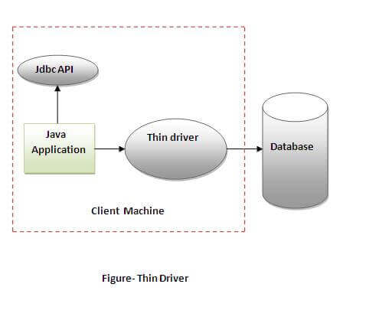

Slide 14
WHICH DRIVER SHOULD BE USED ?
If you are accessing one type of database, such as Oracle, Sybase, or IBM, the preferred driver type is 4.
If your Java application is accessing multiple types of databases at the same time, type 3 is the preferred driver.
Type 2 drivers are useful in situations, where a type 3 or type 4 driver is not available yet for your database.
The type 1 driver is not considered a deployment-level driver, and is typically used for development and testing purposes only.

Slide 15
Steps to connect java application with the database using JDBC
There are 5 steps to connect any java application with the database using JDBC. These steps are as follows:
Register the Driver class
Create connection
Create statement
Execute queries
Close connection

Slide 16
1. Load the JDBC driver:
First step is to load or register the JDBC driver for the database. Class class provides forName() method to dynamically load the driver class.
Syntax: Class.forName(“driverClassName”);
Ex: Class.forName(“com.mysql.jdbc.Driver”);

Slide 17
2. Create connection
Second step is to open a database connection. DriverManager class provides the facility to create a connection between a database and the appropriate driver. To open a database connection we can call getConnection() method of DriverManager class.
Syntax: Connection con = DriverManager.getConnection(url, user, password)
Ex : Connection con = DriverManager.getConnection(“jdbc:mysql://localhost:3306/database_name”,”root”, ”root”);

Slide 18
3. Create statement
The createStatement() method of Connection interface is used to create statement.The statement object is used to execute the query against the database.
.To create a statement object we have to call createStatement() method of Connection interface.
Syntax: Statement stmt=con.createStatement();

Slide 19
4. Execute Query
The execute methods of Statement interface is used to execute queries to the database. The executeQuery method returns the object of ResultSet that can be used to get all the records of a table.
Ex: ResultSet resultSet = stmt.executeQuery(selectQuery);

Slide 20
5. Close database connection
After done with the database connection we have to close it. Use close() method of Connection interface to close database connection. The statement and ResultSet objects will be closed automatically when we close the connection object.
Syntax: con.close();

Slide 21
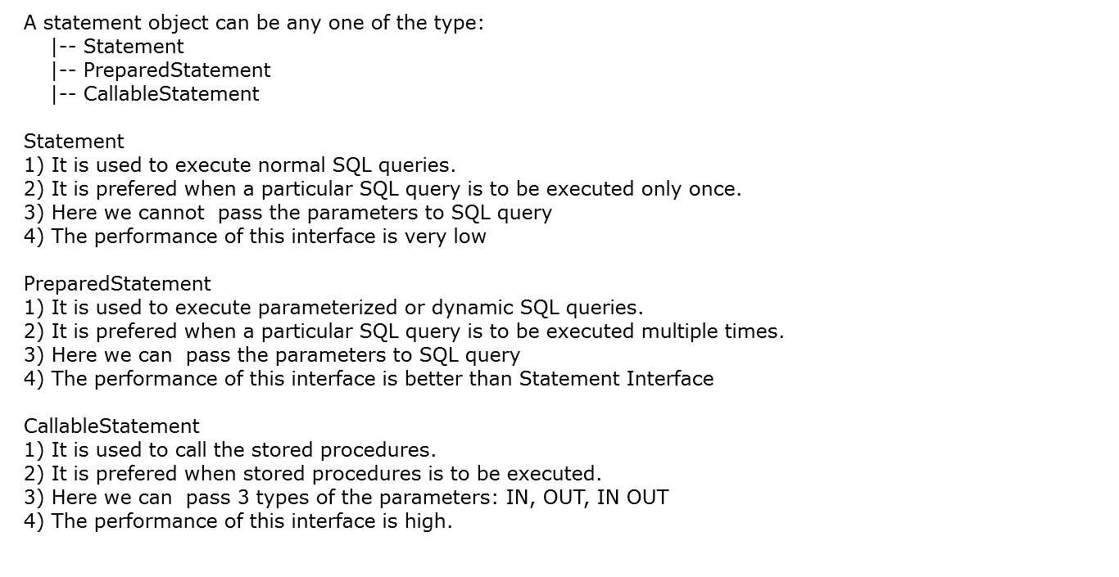

Slide 22
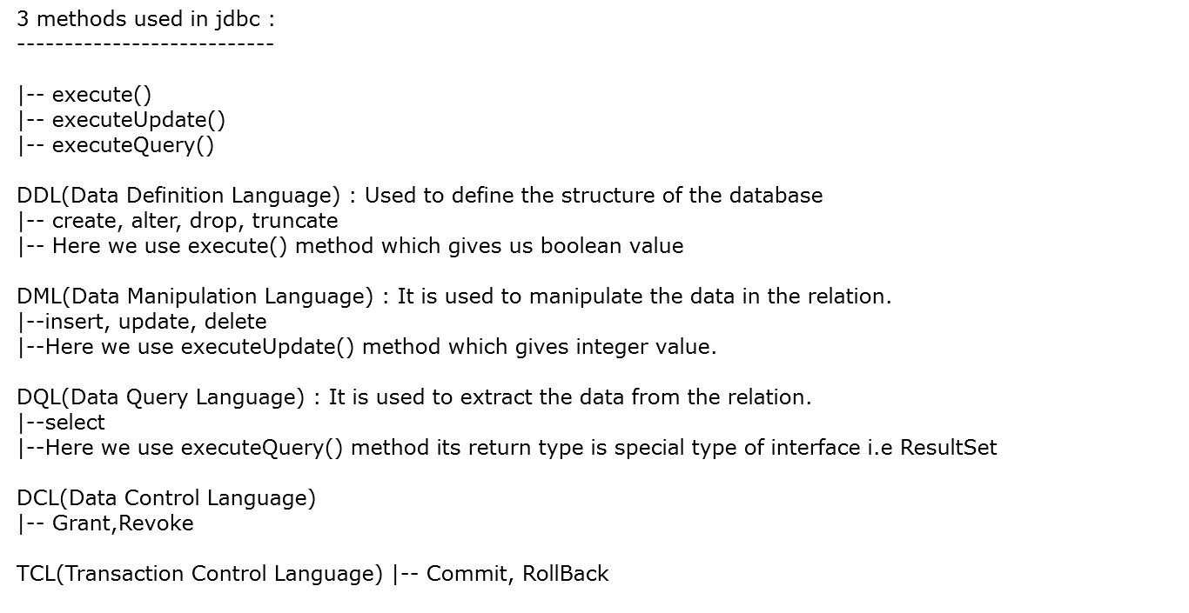
(GRANT-gives user's access privileges to database.
REVOKE-withdraw user's access privileges given by using the GRANT command.)
(COMMIT– commits a Transaction. ROLLBACK– rollbacks a transaction in case of any error occurs.)

Slide 23
Thank You

